Slide 1


NIMIRNDHU NIL HACKATHON 2026
TITLE PAGE
Problem Statement ID - 201
Problem Statement Title - Smart IoT-Based Predictive Hazard Monitoring
System for Fireworks Industry
PS Category – Disaster Management
Team Name (Registered on portal) – Team Layers

Slide 2
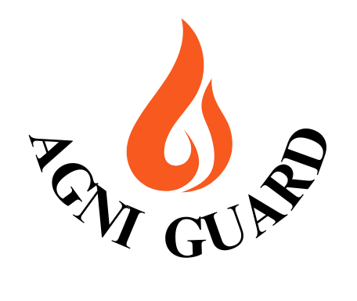
Smart IoT-Based Predictive Hazard Monitoring
System for Fireworks Industry
Proposed Solution

Slide 3

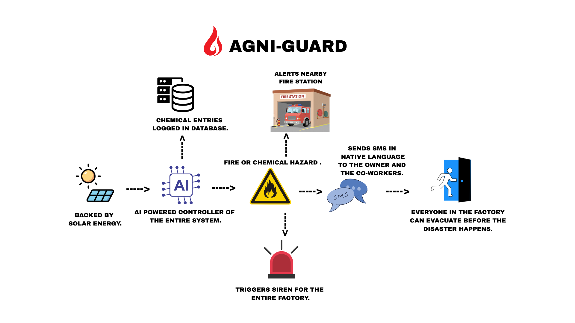
TECHNICAL APPROACH

Slide 4
FEASIBILITY AND VIABILITY
Industry Acceptance: Turbidity-based indirect detection is an accepted research and industry method.
Role of AI: AI detects contamination by learning complex water quality patterns.
Safety & Cost: Eliminates lab risks and costly biosensors.
Feasibility: Combines validity, safety, and affordability.
Detection and Data Limitations: Indirect detection cannot identify specific bacterial species, and limited training data may initially reduce AI performance.
Sensor and Environmental Challenges: Sensor drift, fouling, and environmental factors like sediments or air bubbles can affect turbidity accuracy.
Model & Data Strategy: Use time-series analysis and anomaly detection, and gradually expand training datasets with real-world data.
System Reliability & Ethics: Perform periodic sensor calibration and clearly state system limitations to prevent misuse.

Slide 5
IMPACT AND BENEFITS
Potential Impact on the Target Audience:
  Rural Communities: Provides early warnings for unsafe drinking water to prevent health risks.
  Municipal Authorities: Enables real-time water monitoring without dependence on laboratory testing.
  Educational Institutions: Serves as an affordable platform for hands-on learning in AI and IoT.
  NGOs: Offers a scalable and cost-effective solution for large-scale water safety initiatives.
Benefits of the Solution:
  Social: Improves access to safe drinking water and reduces health risks.
  Economic: Low cost system that minimizes dependence on laboratory testing.
  Environmental: Enables early detection to prevent water wastage and support efficient management.
  Overall Research Basis: Based on WHO guidelines and validated AI-IoT water quality studies.

Slide 6
RESEARCH AND REFERENCES
An IOT-enabled intelligent water quality monitoring system for tourist safety using machine learning. https://link.springer.com/article/10.1007/s44291-025-00070-1
An IOT and AI-Driven Framework for Real-Time Water Quality Assessment and Intelligent Purification Recommendation.https://www.ijert.org/an-iot-and-ai-driven-framework-for-real-time-water-quality-assessment-and-intelligent-purification-recommendation
Low-Cost Internet-of-Things Water-Quality Monitoring System for Rural Area
https://www.researchgate.net/publication/370021809_Low-Cost_Internet-of-Things_Water Quality_Monitoring_System_for_Rural_Areas

